Slide 1

Amazon EC2
(Elastic Compute Cloud)

Slide 2

Definition
• EC2 is one of the most popular of AWS’ offering
• EC2 = Elastic Compute Cloud = Infrastructure as a Service
• It mainly consists in the capability of :
• Renting virtual machines (EC2)
• Storing data on virtual drives (EBS)
• Distributing load across machines (ELB)
• Scaling the services using an auto-scaling group (ASG)

Slide 3

EC2 sizing & configuration options
• Operating System (OS): Linux, Windows or Mac OS
• How much compute power & cores (CPU)
• How much random-access memory (RAM)
• How much storage space:
  • Network-attached (EBS & EFS)
  • hardware (EC2 Instance Store)
• Network card: speed of the card, Public IP address
• Firewall rules: security group
• Bootstrap script (configure at first launch): EC2 User Data

Slide 4

Amazon EC2 – User Data
Definition
EC2 User Data = a script you give to EC2 when launching it.
The script runs automatically at the first boot of the instance.
Purpose → bootstrap the machine (auto-configuration).
Bootstrapping = running commands at startup (like setup tasks).

Slide 5
Key Points
Runs Only Once
User Data runs when the instance starts for the first time.
If you reboot the instance later, it will not run again by default.
Runs as Root User
The script executes with root/admin permissions.
So it can install software, update system, and change settings.
Use Cases (Examples)
Installing Updates → yum update -y (Linux)
Installing Software → Apache, MySQL, Nginx, etc.
Downloading Files → from internet (e.g., GitHub, S3).
Custom Setup → create users, set environment variables, etc.

Slide 6
Launching an EC2 Instance running Linux
• We’ll be launching our first virtual server using the AWS Console
• We’ll get a first high-level approach to the various parameters
• We’ll see that our web server is launched using EC2 user data
• We’ll learn how to start / stop / terminate our instance.

Slide 7
Instance Types
1-What are General Purpose Instances?
These instances are balanced: a mix of compute, memory, and networking.
Good for lots of workloads: web servers, small/medium databases, dev/test, application servers.
AWS keeps releasing new “generations” with better CPUs, faster memory, better networking.

Slide 8
Main Families & Examples
Instance Family | Processor / Architecture | vCPUs / Memory (some sizes) | Network & Other Features | Good For / Highlights
T4g | AWS Graviton2 (ARM) | Up to 8 vCPUs and 32 GiB RAM (for t4g.2xlarge) | Up to ~5 Gbps network, burstable CPU credits model | Cost-efficient for lightweight / bursty workloads (microservices, dev/test, websites)
T3 / T3a | Intel / AMD x86 | Examples: t3.2xlarge has 8 vCPUs, 32 GiB RAM | Burstable; good for workloads with occasional spikes
M6g / M6gd | Graviton2 (ARM) | Medium → large sizes: e.g. 32 vCPUs, 128 GiB RAM etc | High network bandwidth, EBS optimized, sometimes local NVMe storage (for gd variants) | Better price/performance especially on ARM; for apps with more steady CPU usage
M7g / M7gd | Graviton3 (newer ARM) | Larger sizes: memory heavy, more vCPUs etc. | Even better network / memory bandwidth, sometimes instance store with NVMe on “gd” variants | For more demanding general workloads, where memory + CPU both matter
M7i / M8i / M8g | Intel / Xeon / Graviton4 improvements etc | Very large sizes: many vCPUs (up to 192+), large RAM (hundreds of GiB) | High networking & EBS bandwidth, latest Nitro system | Enterprise apps, large databases, large-scale application servers etc.

Slide 9
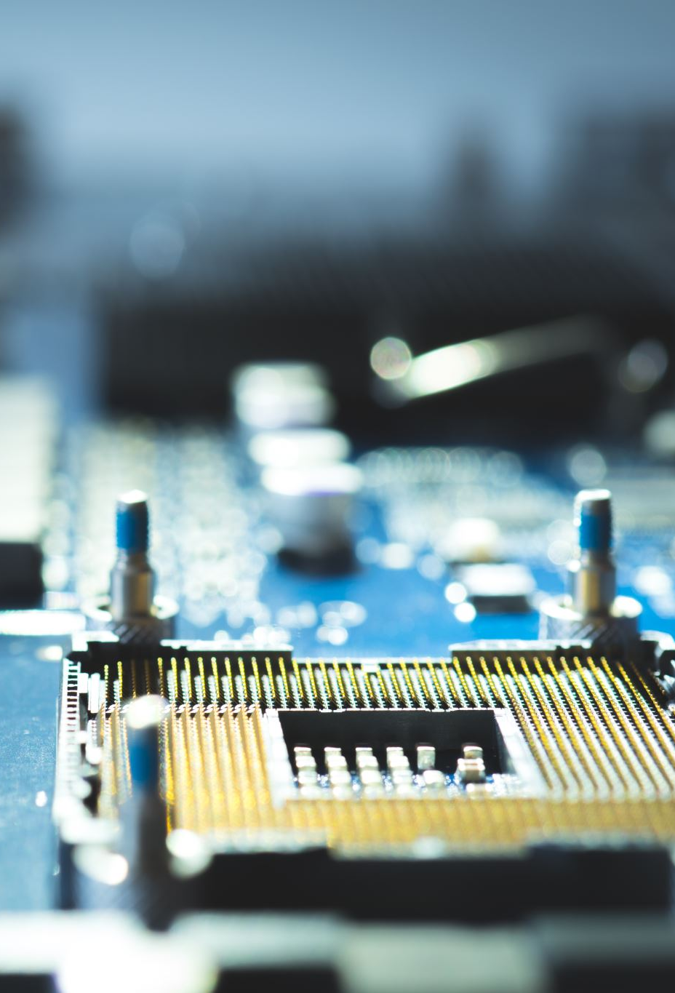
Main Families
T Family (Burstable)
  Examples: T3, T4g
  Use: Low/medium workloads with occasional spikes.
  Model: CPU Credit System.
M Family (Standard, Non-Burstable)
  Examples: M6g, M7g, M7i, M8i
  Use: Steady workloads with balanced CPU & RAM needs.
  Larger sizes available for enterprise apps.
When to Use
T-family (burstable) → Workloads that are idle most of the time but occasionally spike.
  Example: Development/test servers, blogs, small websites, microservices.
M-family (non-burstable) → Workloads with consistent, steady usage.
  Example: ERP system, medium-size databases, backend services.

Slide 10
Compute Optimized Instances
What are Compute-Optimized Instances?
Special EC2 instances for CPU-heavy tasks.
More vCPUs (processing power) than memory.
Best for apps that need lots of processing, not lots of RAM.
Types (Latest Common Ones)
C6g – Based on AWS Graviton2 (ARM) → Cheaper, good performance.
  Example: Data analytics, gaming servers.
C7g (new) – Based on Graviton3 (ARM) → Faster + DDR5 memory.
  Example: Video encoding, real-time analytics.
C5 / C5n – Intel/AMD x86 → Best for workloads needing x86 support.
  Example: Legacy apps, scientific modeling.

Slide 11
Key Features
High CPU power.
High network bandwidth (especially C5n / C7gn).
Some have local NVMe SSDs (“gd”) → very fast temp storage.
Example
Video encoding server → needs CPU 24/7 → use C7g or C6g.
Scientific calculations → needs many cores → use C5n or C7gn.

Slide 12

Memory Optimized Instances
What are Memory-Optimized Instances?
EC2 instances with extra-large RAM.
Best for apps that need lots of memory, not just CPU.
Example: Databases, caching, in-memory analytics.
Common Types
R6g – Based on Graviton2 (ARM) → Cheaper, good price/performance.
  Example: Real-time big data, Redis, Memcached.
R5 – Intel/AMD x86 → Large RAM, steady performance.
  Example: SQL/NoSQL databases, in-memory caching.
R4 (older) – Still used but less efficient than R5/R6.
  Example: Big databases in legacy workloads.
X1 / X1e – Super high memory capacity.
  Example: SAP HANA, Apache Spark, very large enterprise DBs.
High-end (u-series like u-24tb1) – For extreme memory needs (TBs of RAM).
  Example: Very large SAP HANA or scientific workloads.

Slide 13
Key Features
Tons of RAM (hundreds of GBs to TBs).
High network bandwidth.
Great for apps where data must stay in memory for speed.
Examples
Amazon RDS database (MySQL, PostgreSQL) with huge tables → use R5/R6g.
Redis or Memcached (in-memory cache for speed) → use R6g.
SAP HANA (enterprise in-memory DB) → use X1 or u-series.

Slide 14
Storage Optimized Instances (EC2)
Made for: Workloads needing very fast & large local storage (SSD/HDD).
Best for: Big Data, Data Warehousing, NoSQL DBs, Log processing.
Types of Storage Optimized Instances
I3 / I4i
Use NVMe SSD (very fast).
Best for NoSQL DBs, caching, search engines.
Example: ElasticSearch, Cassandra.
I3en / I8g / I7i
Even bigger storage + faster than I3/I4i.
Best for Big Data analytics & data warehouses.
Example: Hadoop, Teradata.

Slide 15
D2
Uses HDD storage (slower but cheap).
Best for sequential read/write on very large datasets.
Example: Hadoop clusters, log storage.
H1
Mix of high throughput + big HDD storage.
Best for large-scale data processing.
Example: Big Data analytics, video processing.

Slide 16
Example to Understand
If you need super-fast DB access → use I3/I4i.
If you need to store petabytes of logs/data → use D2 or H1.
If you want high speed + massive capacity → use I3en/I8g/I7i.

Slide 17
Accelerated Computing Instances (EC2)
Made for: Workloads needing specialized hardware (GPUs, FPGAs, custom chips).
Best for: Machine Learning, AI, Deep Learning, Graphics, HPC (High-Performance Computing).
Types of Accelerated Instances
P3 / P4
GPU-based (NVIDIA V100 / A100).
Best for: Deep Learning, ML training, Scientific simulations.
Example: Training Image Recognition model.
G4 / G5
GPU-based (T4 / A10G GPUs).
Best for: Graphics rendering, Gaming, Virtual Desktops.
Example: Running 3D games or CAD software on cloud.

Slide 18
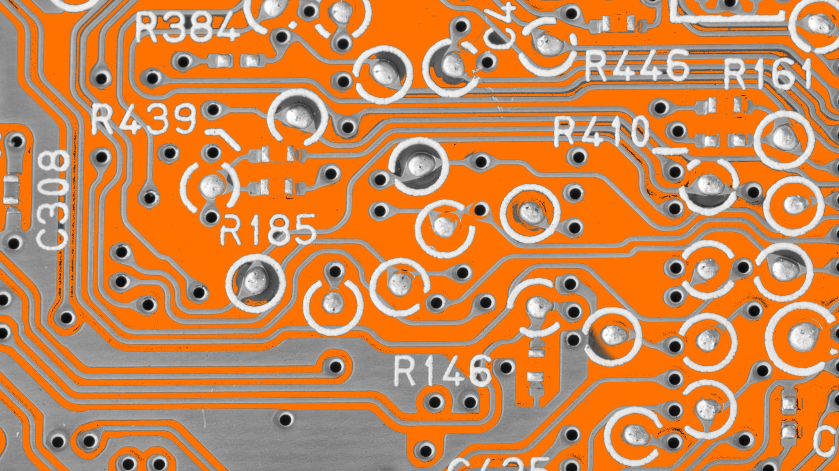
Inf1 / Inf2
AWS Inferentia chips (custom AI chip).
Best for: Machine Learning Inference (fast predictions, low cost).
Example: Running a chatbot that predicts answers in real-time.
F1
FPGA-based (Field Programmable Gate Array).
Best for: Custom hardware acceleration (encryption, genomics, video processing).
Example: DNA sequencing or financial risk modeling.
Example to Understand
Training a deep learning model (like ChatGPT ) → P4
Running gaming / 3D apps → G4/G5
Making fast AI predictions at low cost → Inf1
Doing specialized hardware tasks → F1

Slide 19
HPC Optimized EC2 Instances
Made for: High-Performance Computing (HPC) workloads.
Best for: Complex simulations, deep learning, weather modeling, genomics, rendering, and scientific computing.
Key features:
Powerful CPUs
High network bandwidth (up to 400 Gbps)
Low-latency networking (Elastic Fabric Adapter - EFA)
Types of HPC Instances
Hpc6a
AMD EPYC processors.
Best for: Large-scale simulations (CFD, weather, genomics).
Up to 100 Gbps network with EFA.
Lower cost compared to other HPC instances.
Hpc6id
Optimized for HPC + high storage I/O.
Best for: Finite Element Analysis (FEA), seismic modeling, fluid dynamics.
Includes local NVMe storage for fast data access.

Slide 20
Hpc7g
Powered by AWS Graviton3E processors.
Best for: Energy exploration, molecular modeling, CFD.
Up to 200 Gbps network bandwidth.
Hpc7a
Latest HPC with AMD 4th Gen EPYC CPUs.
Best for: Extreme-scale simulations needing lots of compute.
Up to 300–400 Gbps bandwidth with EFA.
Example to Understand
Weather forecast model → Hpc6a
Oil & Gas seismic simulation → Hpc6id
Molecular biology / Drug research → Hpc7g
Super large scientific simulations → Hpc7a
HPC instances = supercomputers on AWS (best performance + low latency networking).

